Slide 1
Rights of Ways, Tree Lawns and Public Spaces
Background and Context for Understanding Bexley’s Tree Lawn Ordinances

Slide 2
What is a right of way?
Public right of way refers to land set aside for public use, such as streets, roads, sidewalks, and alleys. These areas are typically owned by government entities and are accessible to the general public.

Slide 3
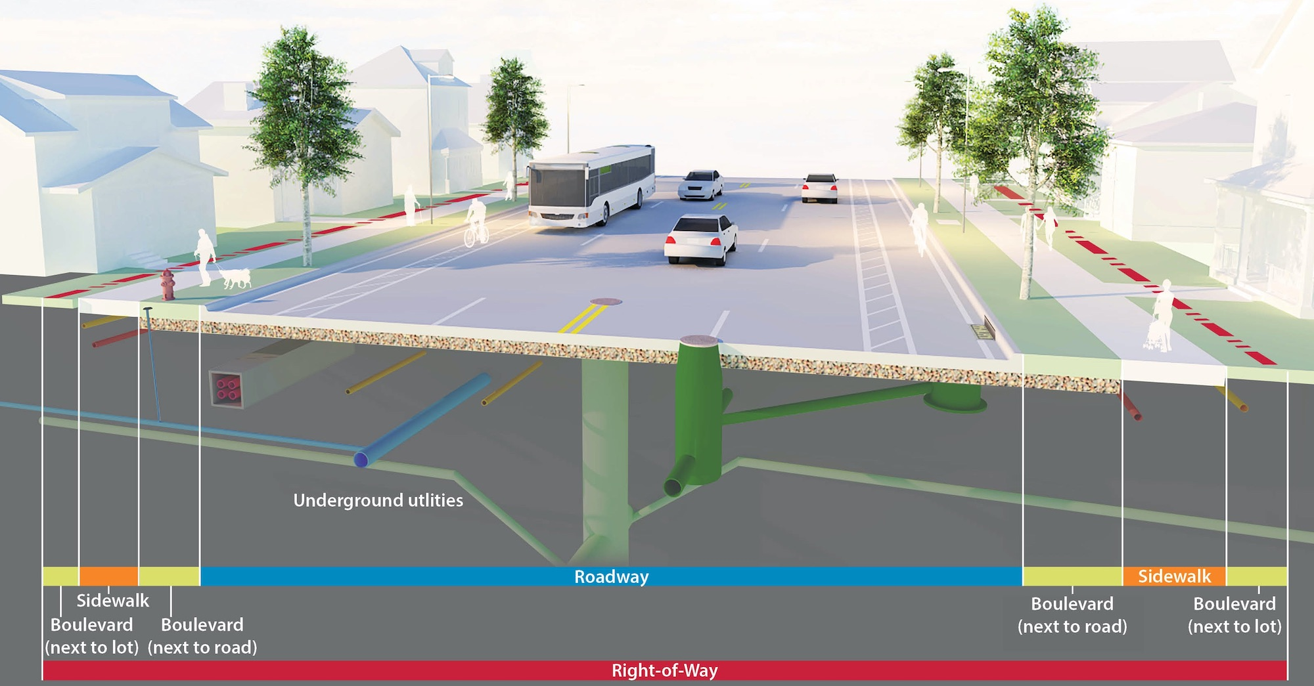
A typical right of way

Slide 4
How are right of ways created?
Right of ways can be created in a variety of ways:
When plats are created, right of ways for the creation of necessary streets can be part of the plat map accepted by the city.
The city can take land by eminent domain
The city can acquire an easement that gives it access, but not ownership to the area in which sidewalks or tree lawns are located.

Slide 5
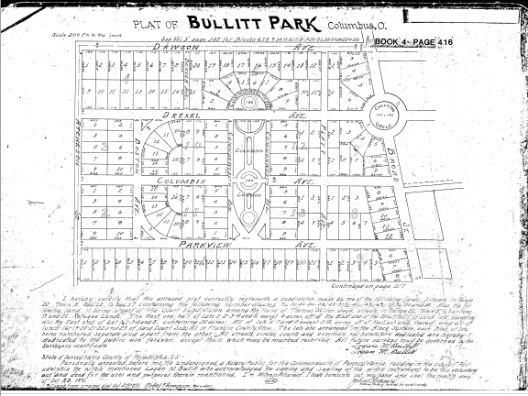
In Bexley, most if not all right of ways were created in plat maps in which the land for the street and adjacent lands were dedicated to the city

Slide 6
What are the parts of the right of way?
The street is obviously the portion of the right of way intended for vehicular traffic (and often bikes)
The tree lawn is defined in two different ways:
In chapter 1026, it is the portion of the right of way from the curb to the place the right of way ends and the adjacent property owner’s land begins
In chapter 1027, it is the portion of the right of way between the curb and the sidewalk

Slide 7
What are the City’s and T&PGC’s Responsibilities for the ROW (both sides of the sidewalk)?
The City is given:
Charge, custody and control of trees, shrubs and evergreens planted or to be planted in or on public streets, alleys, parks and other public places (§1026.03))
Authority to plant, prune, spray, remove and otherwise maintain such trees, shrubs and evergreens (§1026.03, 1026.14)
Exclusive right to plant trees and shrubs between the street and sidewalk (§1027.03(a)(1))
The T&PGC is empowered to:
Develop a written plan for such municipal care and planting program (§288.03(a))
Establish the recommended species and varieties of trees and major landscaping to be planted in the tree lawns and in public gardens (§288.03(b))
Assure satisfactory replacement of trees and shrubs removed from the tree lawn (§1026.04(a))
Approve a request to remove any tree or shrub in a public street, park or public place (§1026.04(b))
Cause removal of any tree or shrub planted inconsistently with Chapter 1026 (§1026.04(c))

Slide 8
Bexley Streets with more than 5 ft. ROW behind the sidewalk
• Ardmore Road from 250 FT north of Elm to Broad and north from the first alley north of Broad to Ruhl
• Ashbourne Place
• Ashbourne Road
• Bexford Place
• Boston between Parkview and Drexel
• Bullit Park
• Bryden Road between Parkview and Drexel
• Cassady from Main to Broad (both sides), from Maryland to Allegheny (east side), and from Maryland to Delmar (west side)
• Cassingham from 250 north of Elm to Broad and from the first alley north of Broad to Ruhl
• Charles from Sheridan to College
• Columbia
• Dale from Parkview to Cassingham
• Dawson from Fair to Broad
• Delmar
• Denver from Stanberry to Ashbourne
• Drexel from Main to Caroline
• Elm from Dawson to Cassady
• Maryland from Parkview to Stanwood
• Parkview from Main to Caroline
• Pleasant Ridge from 845 Pleasant Ridge to Francis
• Plymouth from Cassady to Dawson
• Remington from 200 ft. north of Elm to 200 ft. south of Broad and from 200 ft. north of Broad to Ruhl
• Roosevelt from Main to Fair and from Elm to 400 ft. north of Denver
• Ruhl from Northview to Cassady
• Stanberry from Broad to Maryland

Slide 9
What relationship between the adjacent property owner and the right of way?
Between the street and sidewalk:
Maintain the tree lawn as grass/lawn area (not to exceed 8” in height)
Mulch or plant flowers in 3 ft. radius around trees (§1027.03)
May not plant prohibited species (including shrubs) on the side of the sidewalk on the house side (§1026.03))
Protect trees during construction and not damage trees in the tree lawn (§1026.05-.07, .09)
Prune trees obstructing the sidewalk and removed diseased trees (§1026.12-.13)

Slide 10
What is our understanding of the right of way?
What is our understanding of land “dedicated” to the city?
Is it akin to the “commons”?
Is it different than public parks and the like?
What voice should adjacent property owners have with respect to such lands?
Do we have different views of the space between the street and sidewalk and the space on the other side of the sidewalk?
What are the respective roles of the T&PGC and city staff?
What are we not asking that we need to ask?

