Slide 1

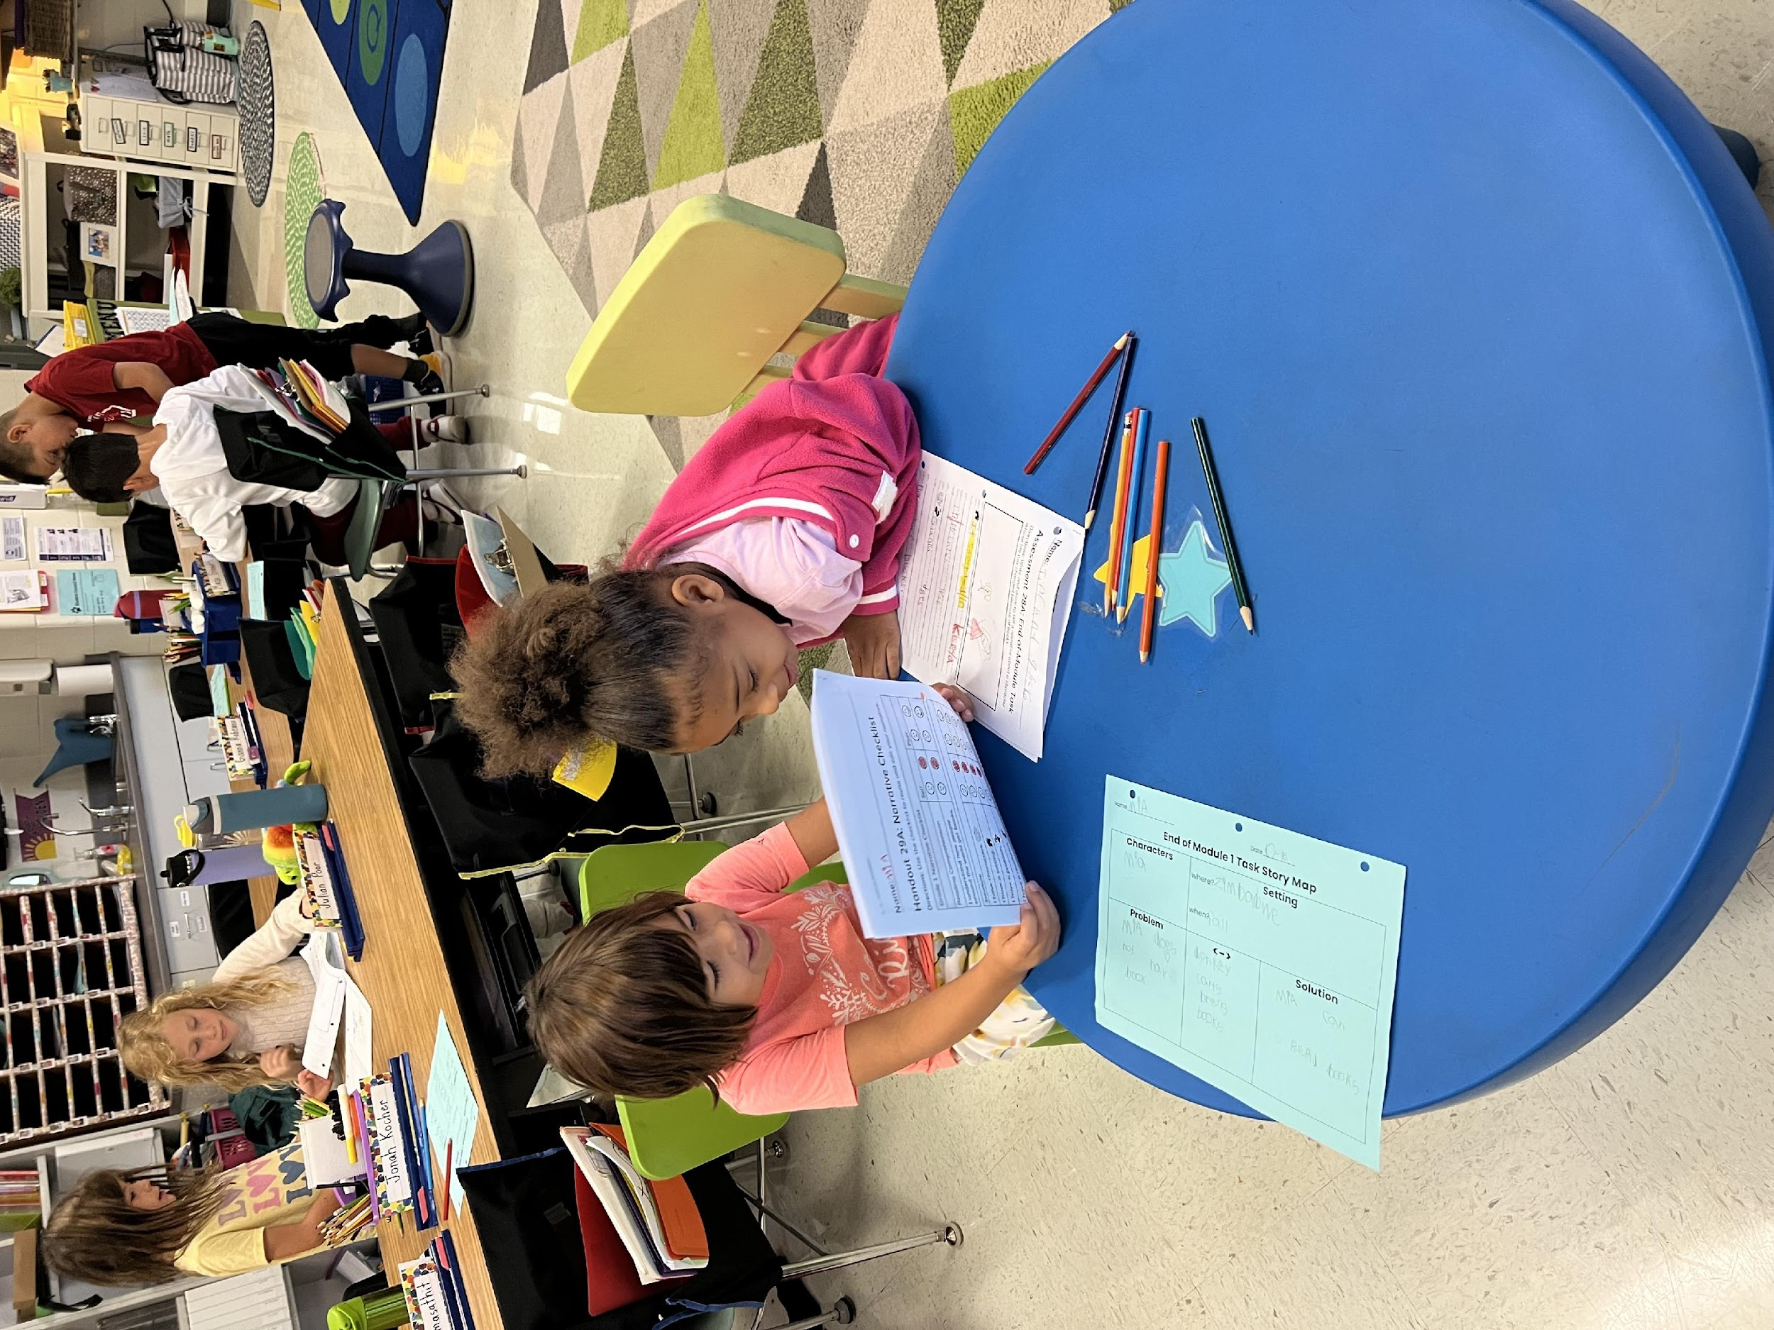

BEXLEY CITY SCHOOLS
UPDATE
ADDRESS TO BEXLEY CITY COUNCIL
FEBRUARY 11, 2025

Slide 2

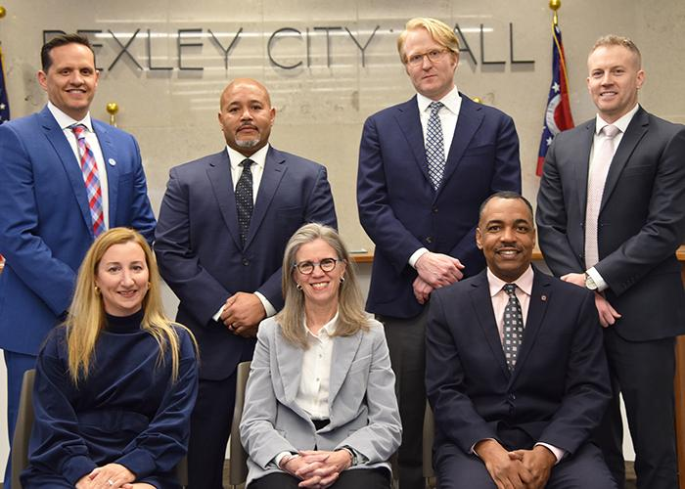
TO OUR BOARD

Slide 3

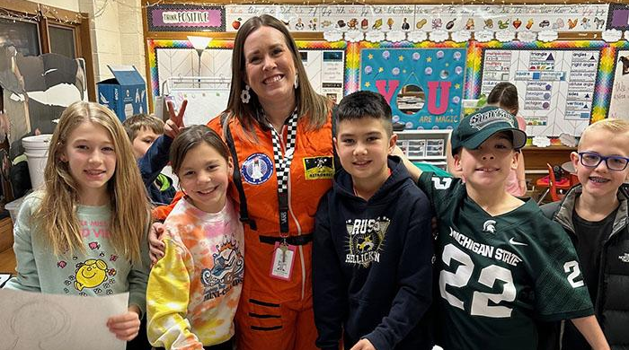
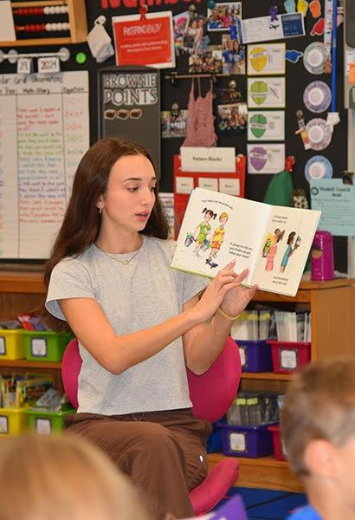
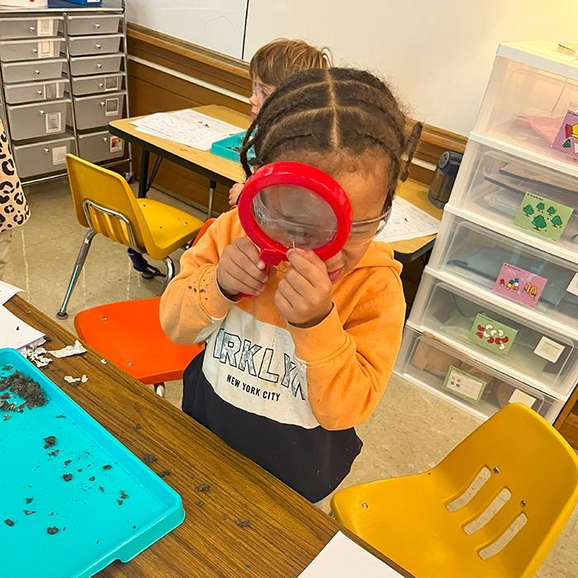

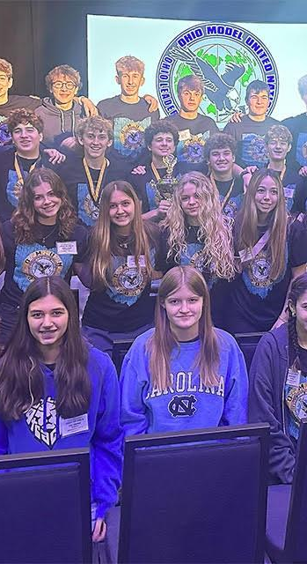

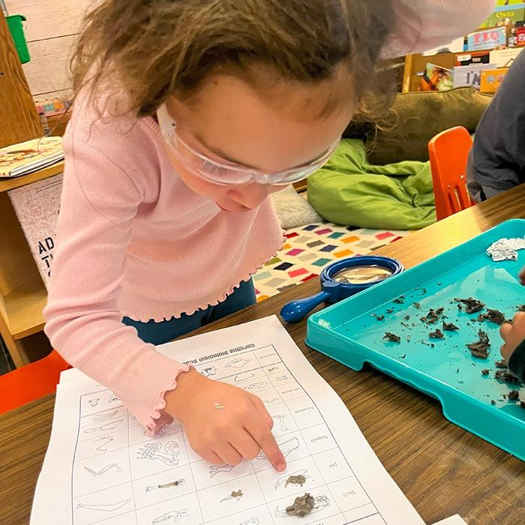
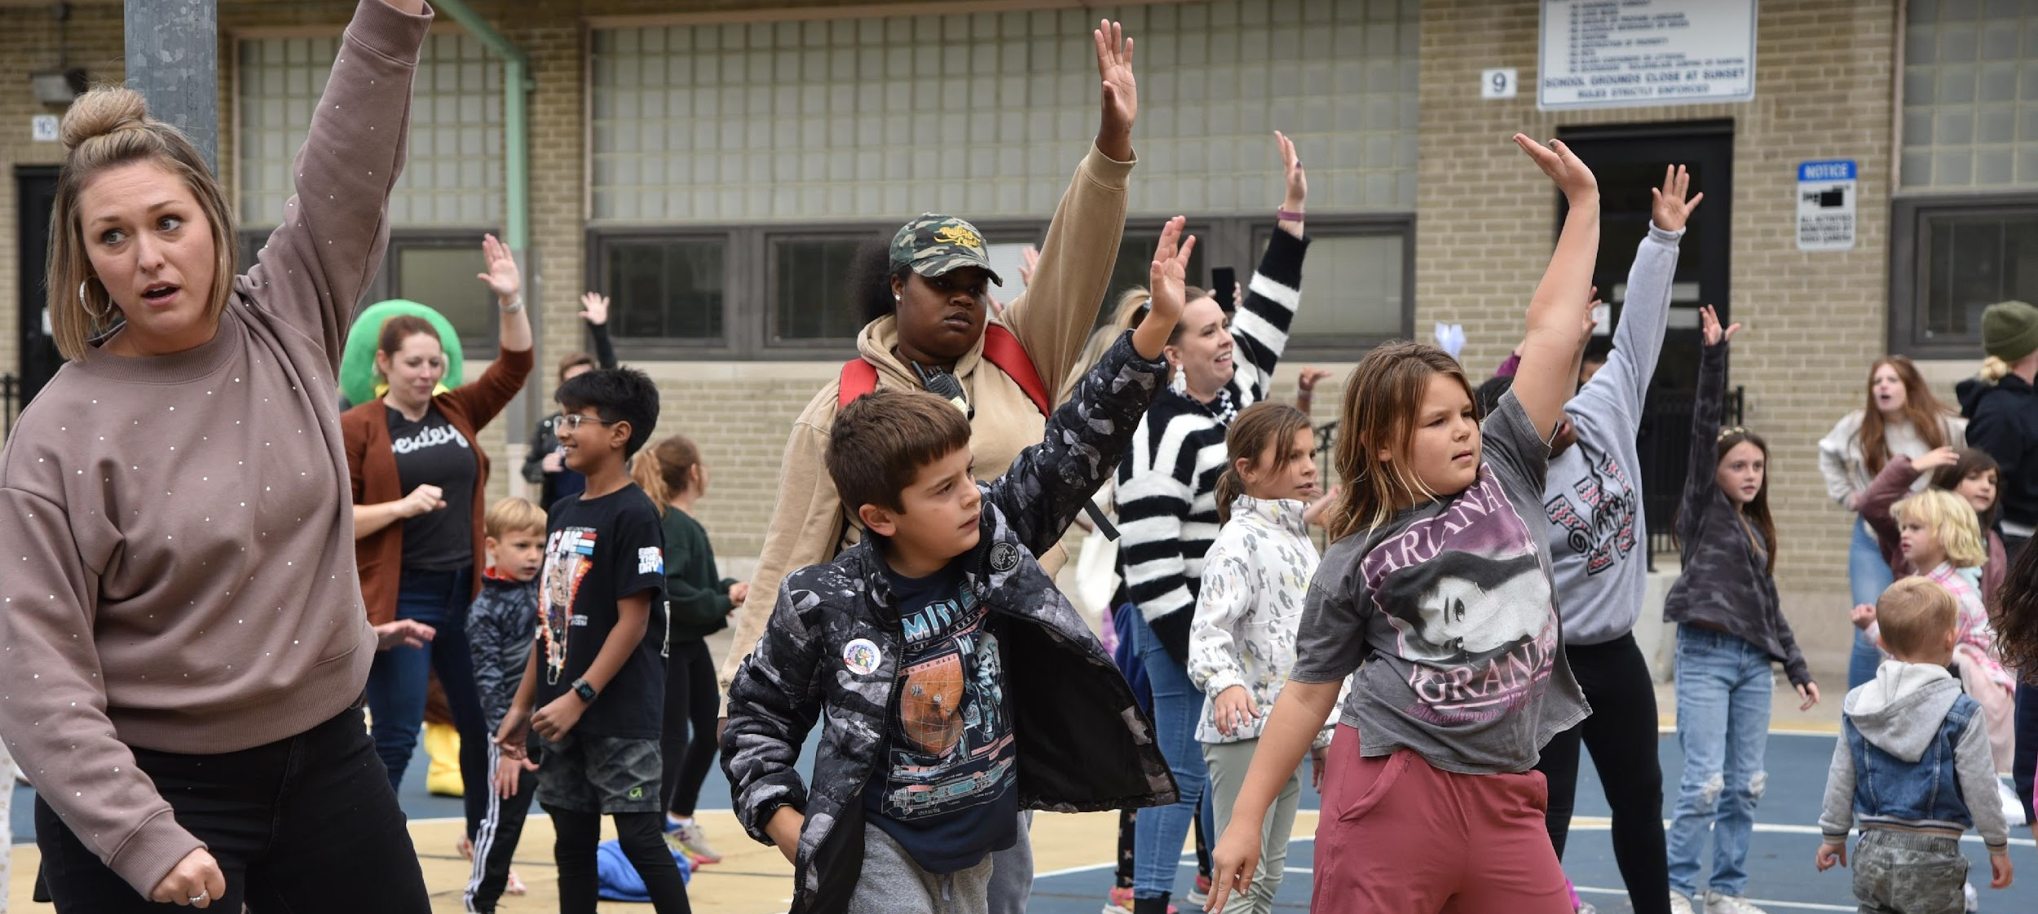
OUR MISSION
THE DNA OF BEXLEY SCHOOLS:
Learn with Curiosity
Demonstrate Kindness
Embrace Equity
“Where students, staff, and families feel supported,
valued , and inspired to achieve.”

Slide 4
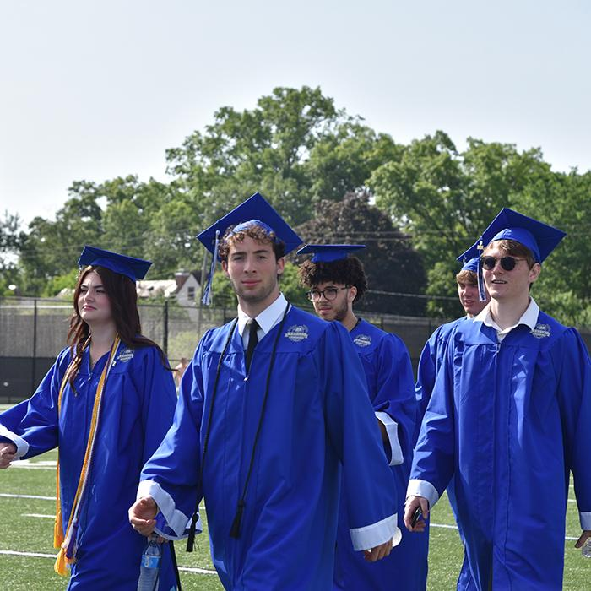
ACADEMIC EXCELLENCE
98%
93.4%
Graduation Rate
State Performance Index
Average
ACT:
#2
SAT:
24
1275
Public High School in Ohio
(U.S. News & World Report)
Rating from the Ohio Department of Education

Slide 5
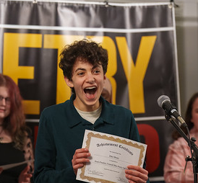

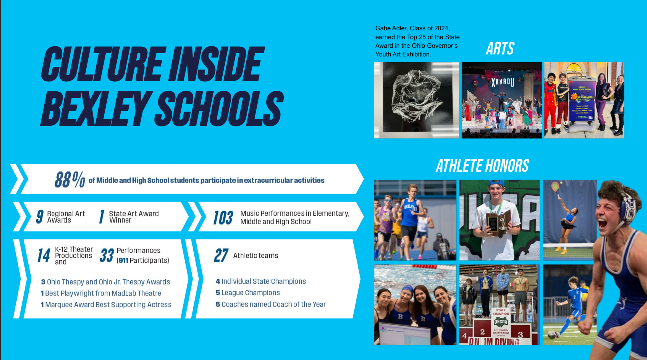
Notes:
Four State Champs - Henry Lassaard, Amaya Bowles, Jackson Monus, Marius Garcia
Zeke Moses - Poetry Out loud champ
Maddy Lafollette - Disney Dreamer
Gabe Adler - Top 25 Governor’s Youth art exhibit
Spelling Bee Winners

Slide 6
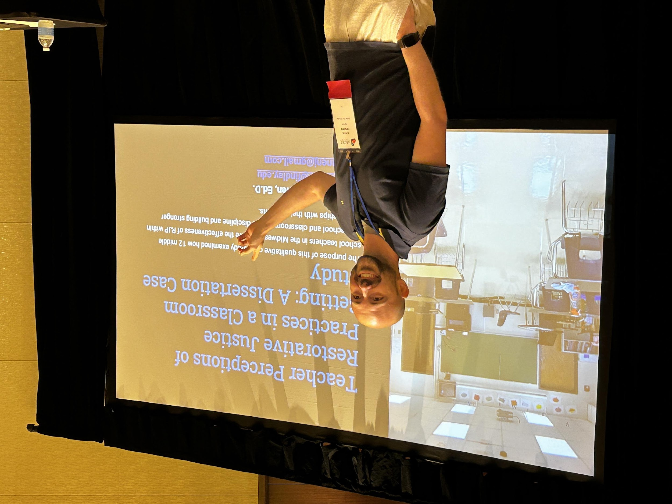
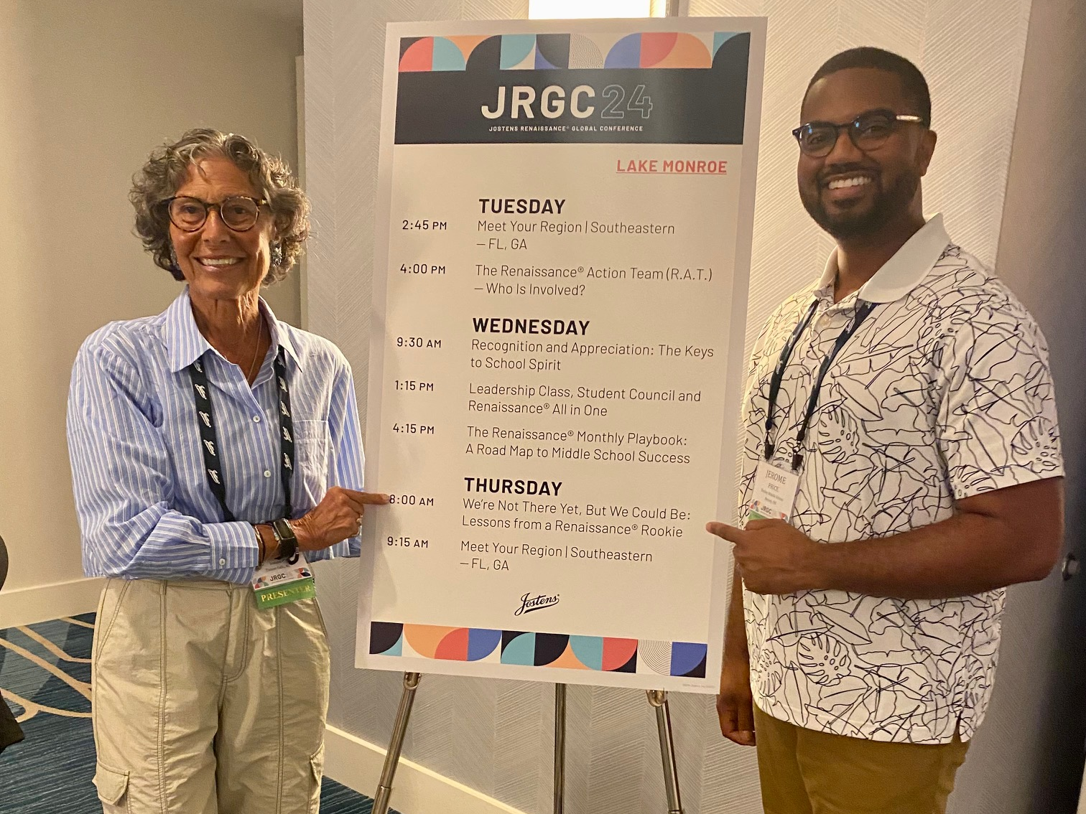
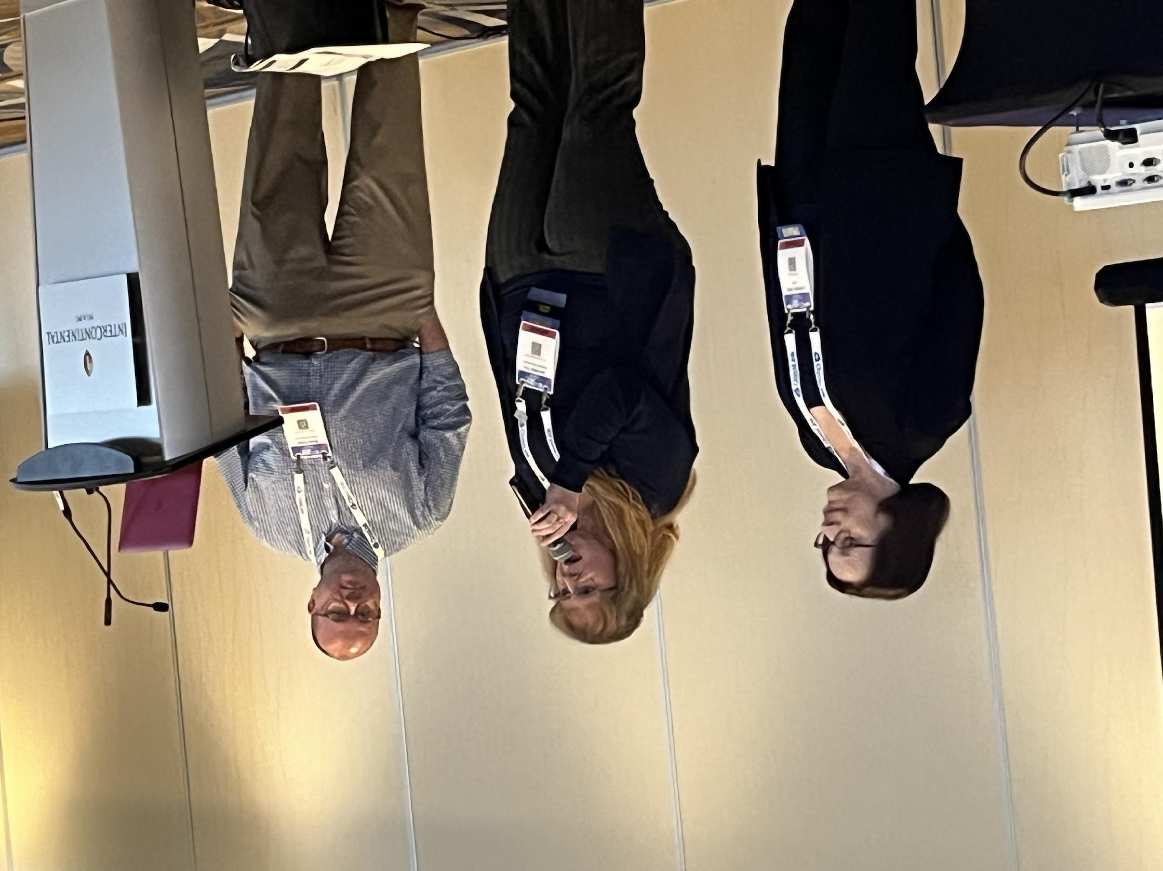
LEADING THE WAY IN EDUCATION
HIGHLIGHTS OF STAFF CONTRIBUTION
DR. JUSTIN DENNEN
JEROME PRICE
BRAD PETTIT
Restorative Justice Practices
Energizing School Culture
Technology Leadership
Empowering students through innovative and forward-thinking leadership.
Notes:
#1 indicator of success is teacher - #2 is admin
\This national conference on community and restorative practices will provide four days of valuable information that I can bring back to the Climate Committee and staff, further aiding the implementation within our district. Additionally, as the first person selected to present a dissertation study at this conference, this will offer valuable exposure and highlight the positive research conducted within our schools.
Jostens Renaissance® - Last summer, I had an opportunity to travel to Dallas, Texas for the Jostens Renaissance Global Conference. I had a wonderful time! The Jostens Renaissance team recently interviewed me and I was able to shout out some of the great things happening at Bexley Middle School.
He presented at the National Consortium for School Networking Conference.
He's also helping to lead the Ohio Digital Wellness Alliance.

Slide 7
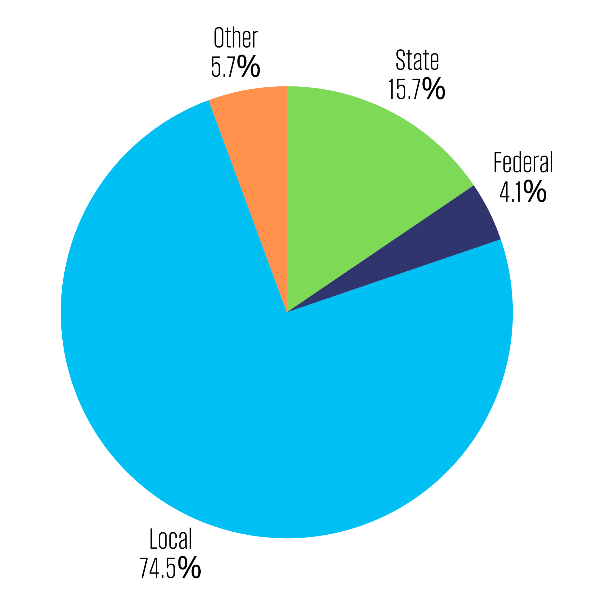
FINANCIAL STEWARDSHIP IN ACTION
State Audit Award
(4 years consecutively)
Our Revenue
Source: Ohio Department of Education & Workforce
70.8%
of funds spent on classroom instruction
We qualify for $1,658/student in state formula funding.
Our community contributes $14,728/student.
“The financial stability of our school district is vital in providing all of the supports and opportunities to our most precious resource: our students”

Slide 8
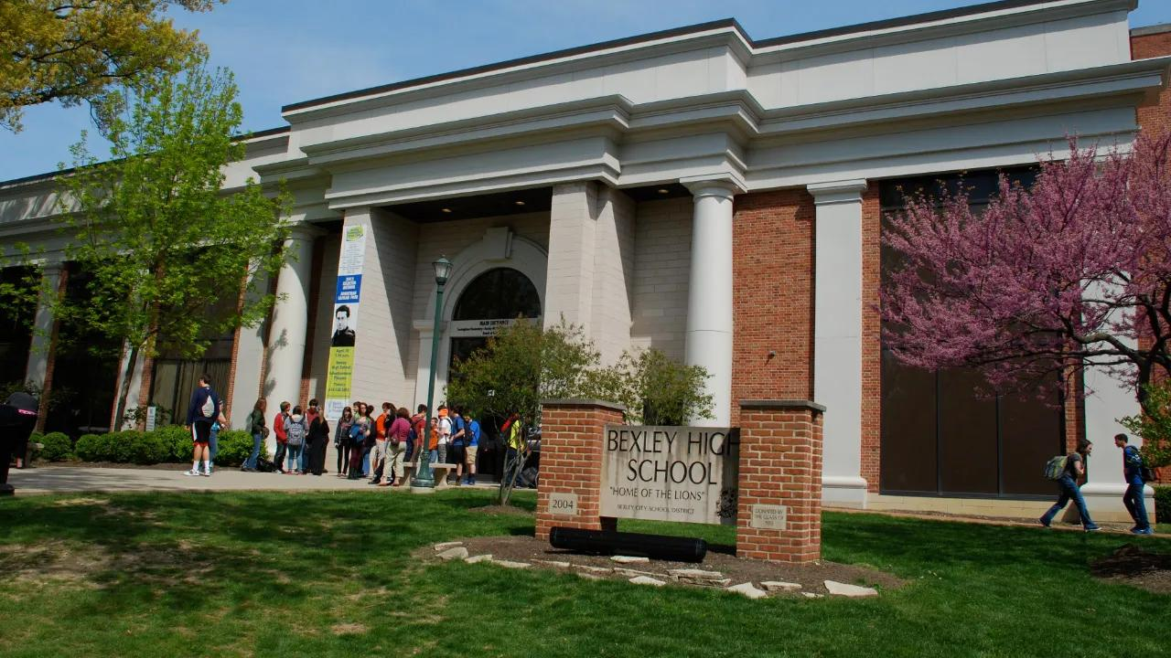
FACILITIES: A STRATEGIC PRIORITY
Focused on maintaining aging facilities and meeting students' current needs.
Input gathered from community, staff, students, and families.
Guided by architects and a facilities committee.
Next step: Decisions Phase - Board members will consider the proposed plan.
Notes:
includes Cassady

Slide 9
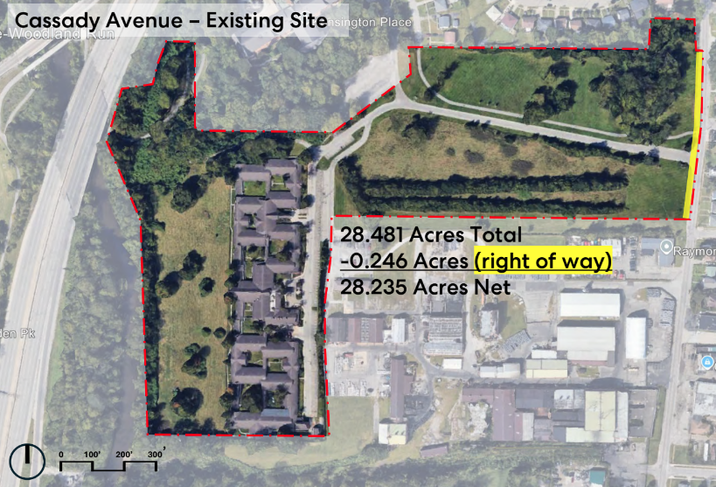
Cassady Avenue Purchase
Strategic Plan Goal 2.2: Explore alternative facilities and buildings through partnerships, grants, leases, and purchasing opportunities.
Notes:
As Dr. Fine announced, we made significant progress in our Strategic Plan Goal 2.2: which directs us to explore alternative facilities and buildings through partnerships, grants, leases, and purchasing opportunities. I am happy to share we have entered into an agreement to purchase over 28 acres of land just north of Fifth Avenue on Cassady Avenue for $6 M. We are expected to close tomorrow. We are excited about the impact this property will have on the short- and long-term needs of the District. Creating and shifting athletic fields to a new athletics campus also creates a pathway for construction for new additions and renovated spaces on the Cassingham Complex. It will provide us with the flexibility to respond to issues that may arise in the next 100 years. This property may be the solution to Issues that are not yet know to us.
We have been quite busy since we first heard this land was available in late May 2024. Negotiations on a purchase agreement took place over the summer and yielded a signed document with an agreed upon price of $6,000,030 on September 13, 2024. The signed agreement gave us until December 2, 2024 (75 days) to conduct our due diligence and we agreed to close no later than December 13, 2024. I will explain more about that later in my presentation.
The creation of a second campus dedicated to athletics will address our severe deficiencies in field space in serving our nearly 800 middle and high school athletes. We are excited by the prospect of our athletes not having to practice on ungraded fields that do not also serve as a dog park. We were also impressed with the success of the Columbus School for Girls split campus model with an academic core campus separated from their athletic facilities.

Slide 10
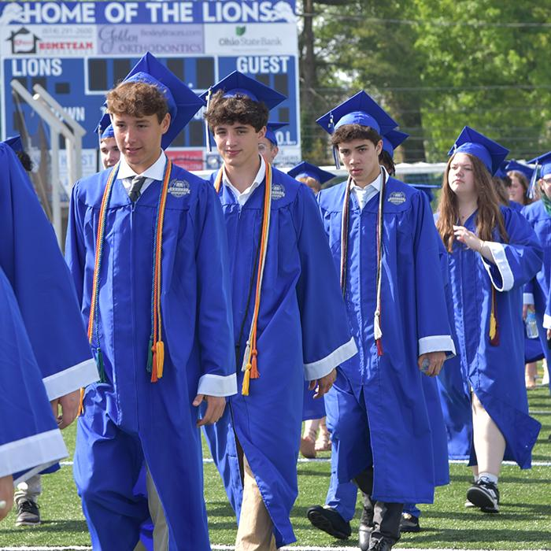
A COMMUNITY ROOTED IN PRIDE
“Our success is made possible by your trust and investment.”
The Bexley community has shown decades of support for our schools!!!!
Key Partners Who Make a Difference:
Bexley Education Foundation: Supporting innovation and enriching educational experiences.
City of Bexley: A vital partner in building a stronger community for our students and families.
Bexley Parks and Recreation: Enhancing opportunities for student wellness, athletics, and enrichment.
Chief Lewis and the Bexley Police Department: Ensuring the safety and well-being of our school community.
One Bexley: Leading the conversation on equity and inclusion city-wide.
Community Organizations: Powerful partnerships across diverse backgrounds fostering civic engagement and strengthening community fabric.
Notes:
Trifecta of success
One Bexley, BMPA, DARN, PTOs, Bexley Pride, ERIBS

Slide 11
THANK YOU!

