Slide 1

Franklin County Auditor Office Updates Fall 2024

Slide 2
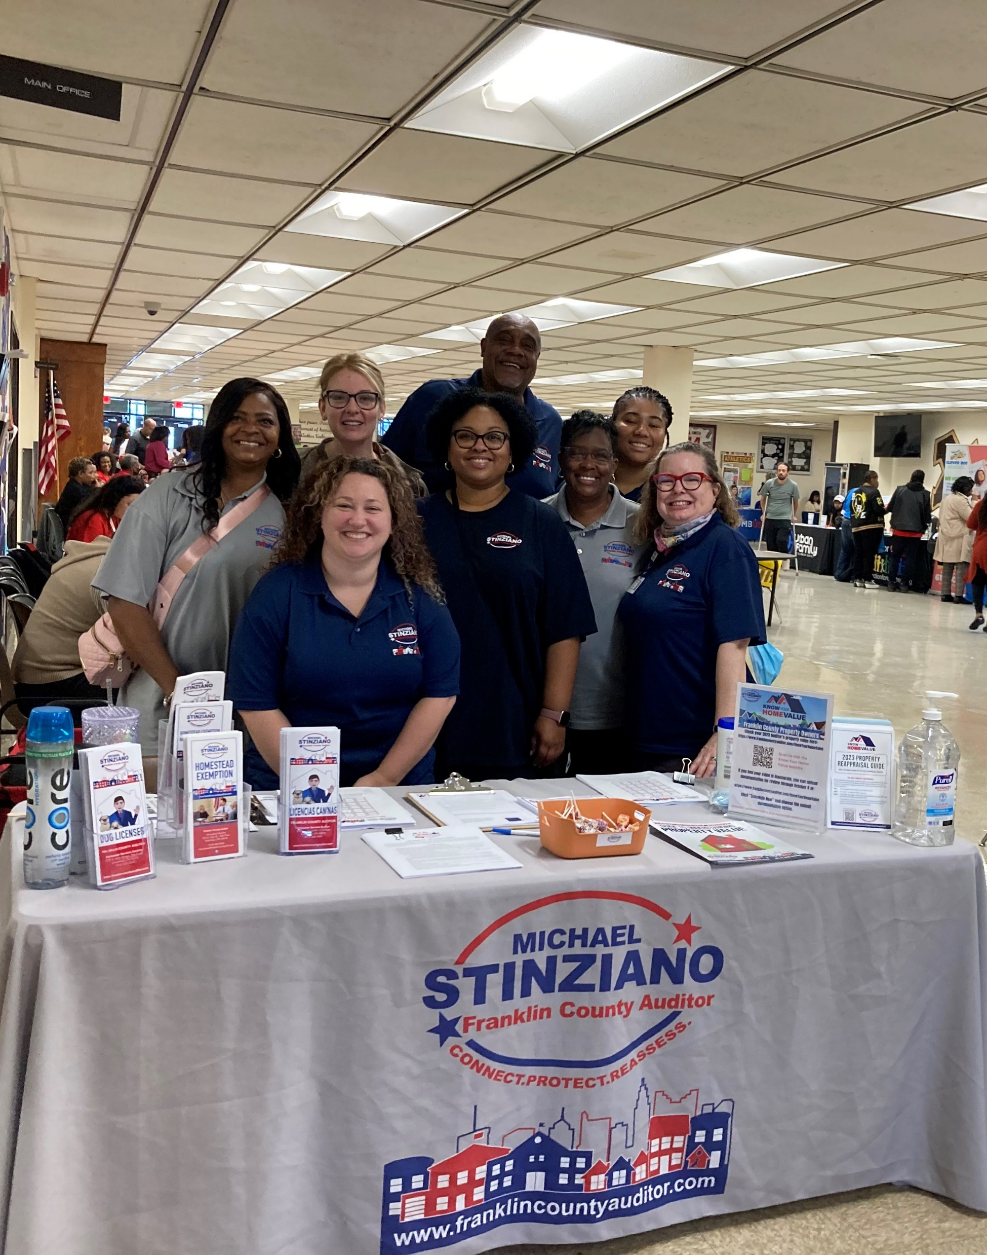

Real Estate
Continuing to process applications for Tax Year 2023.
November 8 – Board of Revision Applications will be available for Tax Year 2024.

Slide 3

Know the Value of Your Vote
WHAT’S ON MY BALLOT?
You may have one or more levies on your ballot which may change how much you pay in property taxes.
To see the estimated impact to your property taxes, visit: franklincountyauditor.com/levyestimator
November levy information will be available on October 1, 2024

Slide 4
Legislative Activity
Your Franklin County Auditor’s Office continues to advocate to our state lawmakers on legislation that would modernize current laws and also provide impactful property tax relief.
The office supports:
Senate Bill 244
Senate Bill 271
“The Stinziano Solution”
Modernizing the Homestead Exemption

Slide 5

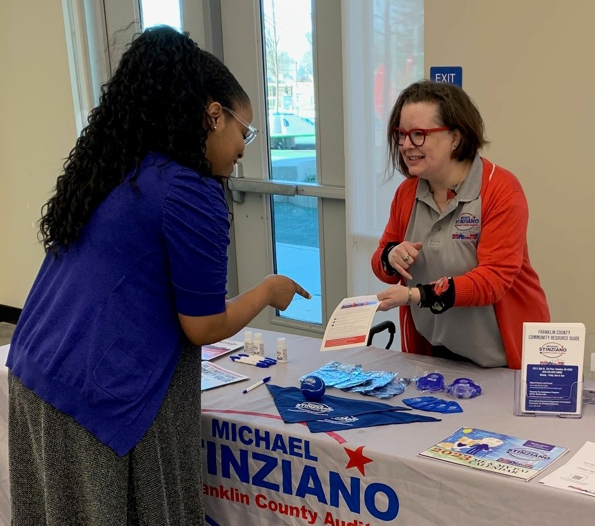
Important Dates
October 1
Tax Levy Estimator online
October 12
Affordable Housing Resource Fair
10am – 2pm at Whitehall Yearling High School
November 8
Board of Revision will begin accepting tax year 2024 complaints
November 16
Shred Hunger, free e-waste and shredding
1550 Georgesville Road, 10am – 1pm
December 1
Dog Licensing season opens
https://doglicense.franklincountyohio.gov/

Slide 6

Questions?
Contact:
AuditorStinziano@FranklinCountyOhio.gov
614-525-HOME (4663)

